Slide 1
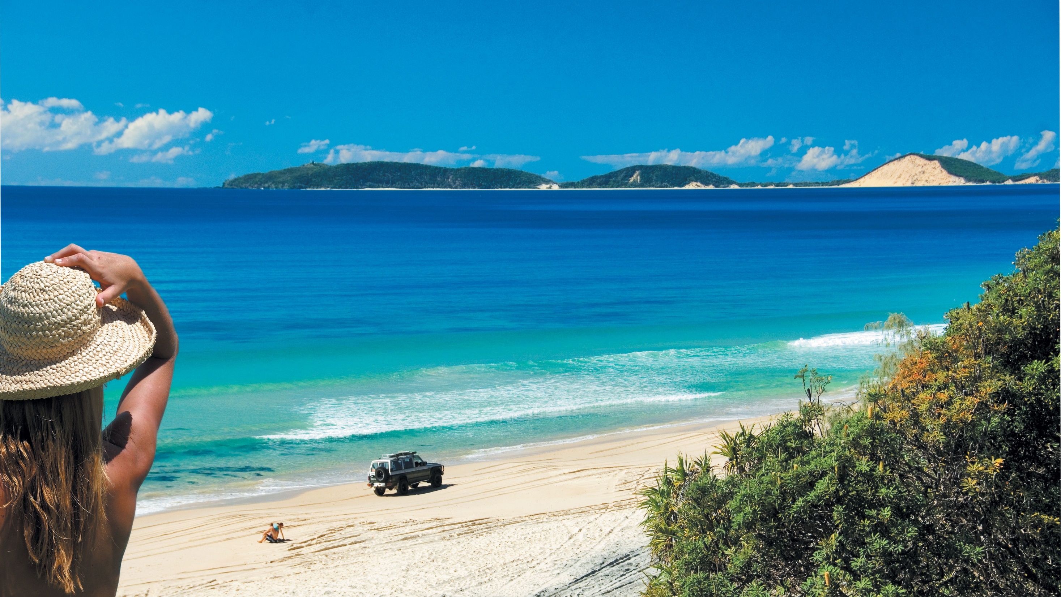
Notes:
Great Beach Drive 4WD Tours is a division of Surf & Sand Safaris. Established in 1973, this family-owned business is one of Queensland’s longest operating 4WD tour companies. We are the only tour operator offering a dedicated Great Beach Drive tour from Noosa to Rainbow Beach.

Slide 2
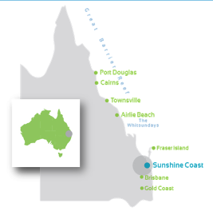
Where is The Great Beach Drive
Just 1.5 hours north of Brisbane
Located on the Sunshine Coast, with daily departures ex Noosa to Rainbow Beach
3 hours north of Gold Coast
Gateway to World Heritage listed Fraser Island
Notes:
Escape the bitumen and discover the sand dunes with Great Beach Drive 4WD Tours. Our tour takes place on Queensland’s Sunshine Coast from Noosa to Rainbow Beach, in an experience that can only be described as exhilarating.
Accessible only by 4x4, imagine the freedom and pure exhilaration of driving more than 70km on white sandy beaches with the Pacific Ocean on one side and natural bushland on the other side. We also offer private charters for our one-day tour. A Private Charter means private travel in a 4x4 Wagon (up to 4 adults and 2 children), or 4x4 mini-bus (maximum 10 passengers), as well as freedom to control the itinerary and a more personalised interaction with the tour guides. Guests can also choose a gourmet picnic lunch or lunch at Rainbow Beach Surf Club.

Slide 3
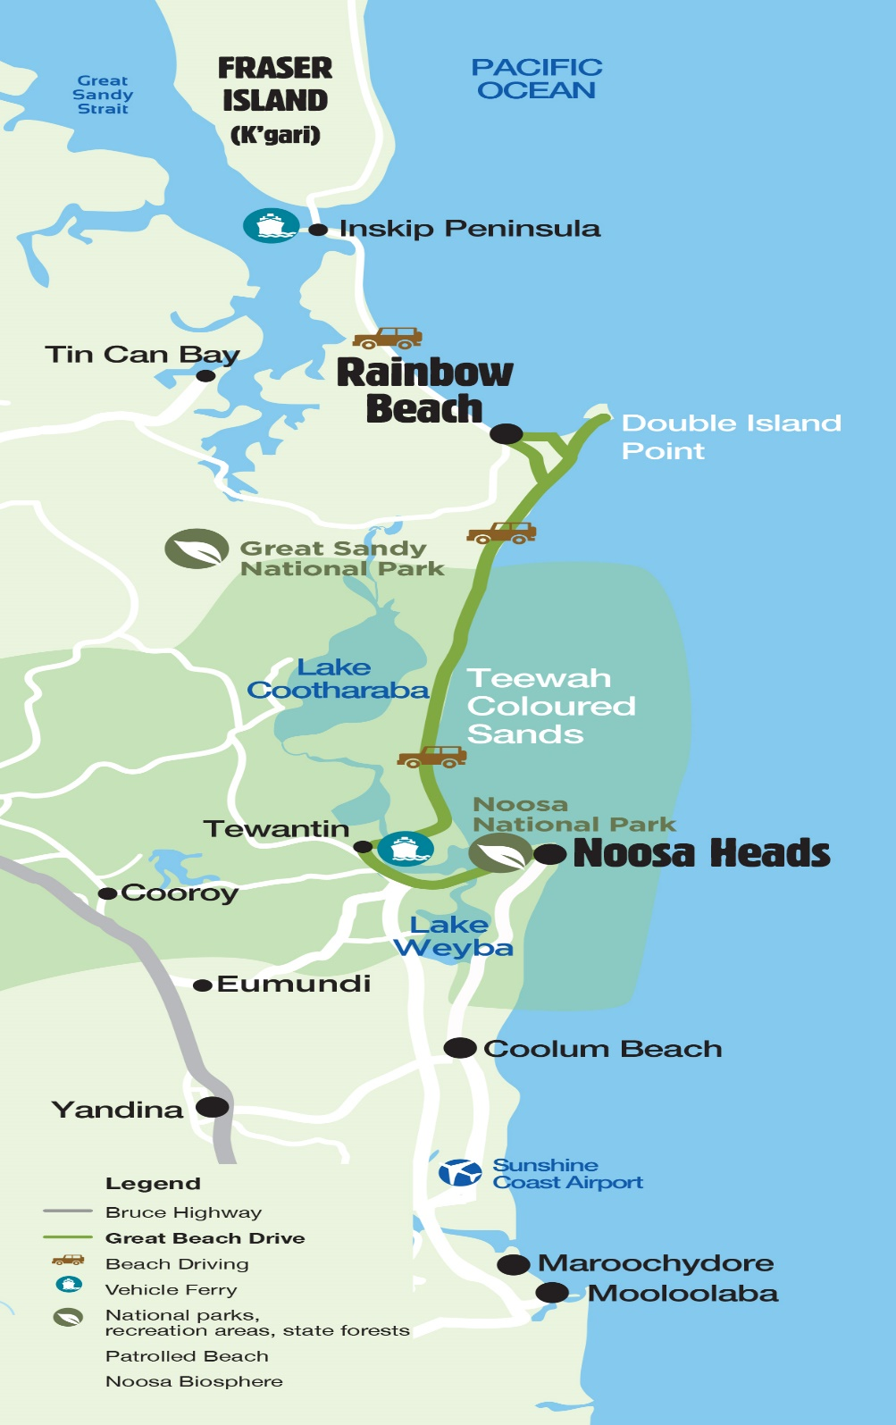
Tours are approximately 8 hours
in duration, departing daily from
Noosa Marina.
Complimentary pick ups and returns
from designated Sunshine Coast
accommodation and pick up points

Slide 4
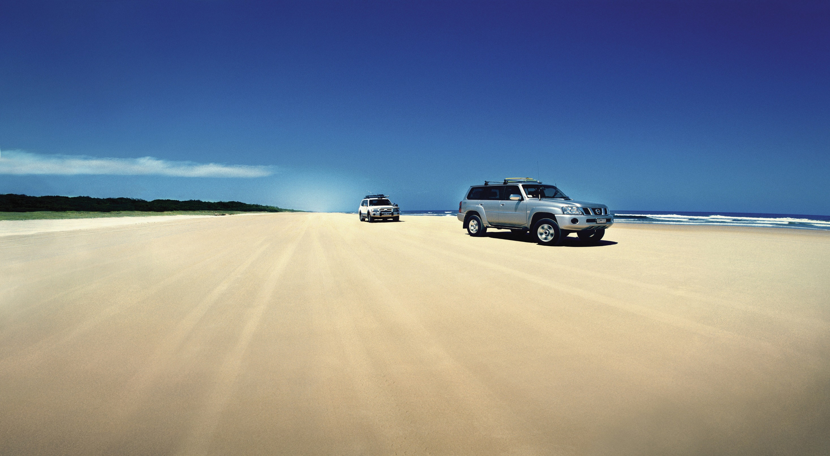
Forget the bitumen & enjoy over 70 kilometres
of white, sandy beaches on one side &
National Parks on the other
GREAT BEACH DRIVE
Notes:
Our tours are beach driving experiences, however due to tide and beach conditions, one way of the tour may need to be taken via the Noosa Hinterland. Tour guides will explain these circumstances to guests on the day, should they apply.

Slide 5
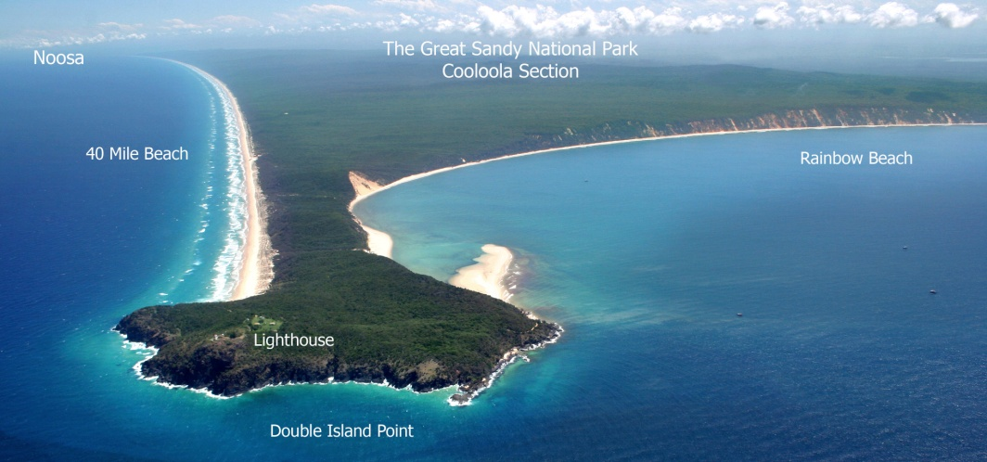
TOUR HIGHLIGHTS
Notes:
Great Beach Drive 4WD Tours are Advanced Eco Certified and are the only tour operators with direct and extended vehicle access to protected Double Island Point Lighthouse, as well as the only operators who hold interactive coloured sand presentations as part of their tours.

Slide 6
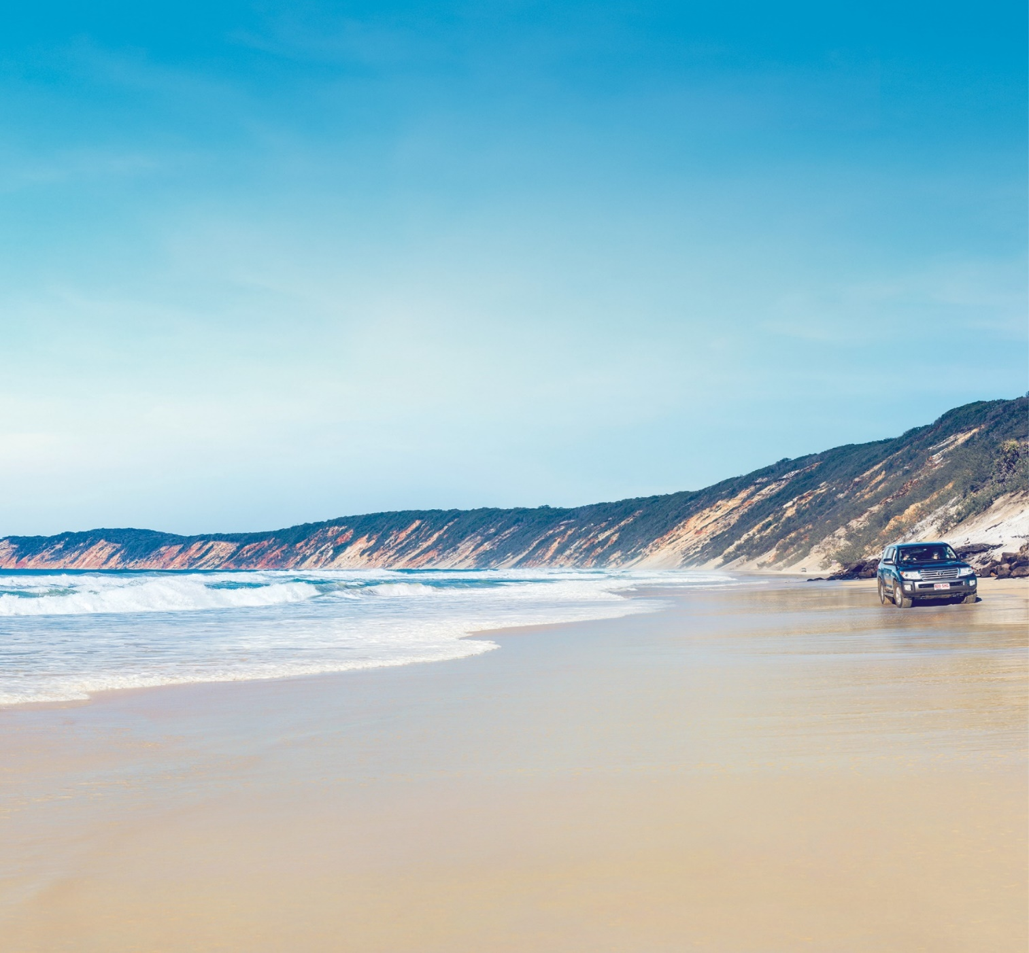
Key Selling Points
Family owned and operated
Only dedicated Noosa to Rainbow
Beach operator
Intimate, flexible &
personalised tours – more
time out of the vehicle, less time in the vehicle
Local, Passionate Guides
Advanced Eco Accreditation
Notes:
From start to finish, our tour itineraries offer freedom to explore, to stay a little longer, and to make the most of this unique experience. Our local and knowledgeable take you to the best-kept secrets of this coastline. Tours leave daily and Great Beach Drive 4WD Tours provide pick up and drop off, 4WD vehicles, experienced local guides, and a full day of discovering one of Australia’s most dramatic coastlines. Our tours are suitable for guests with sufficient mobility to climb two or three steps, however will benefit from fittings and fixates to aid balance. We are also suitable for guests who depend on the use of a wheelchair.

Slide 7
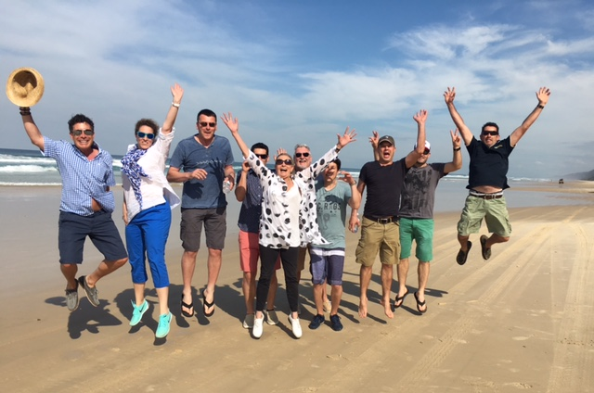
FIT’s, Couples, Families, Small Groups
Notes:
We operate Intimate, flexible and personalised 4WD tours to showcase and experience the Great Beach Drive and Australia’s Nature Coast. We cater for individuals, couples, families and small groups (maximum 36 passengers, with a maximum 10 people for vehicle. Our tours cater for people who are mobile impaired, and babies over 6 months of age with booster seaters provided on request. Should your clients want a little more freedom and a more personalised experience, private tours are available for individuals and groups.

Slide 8
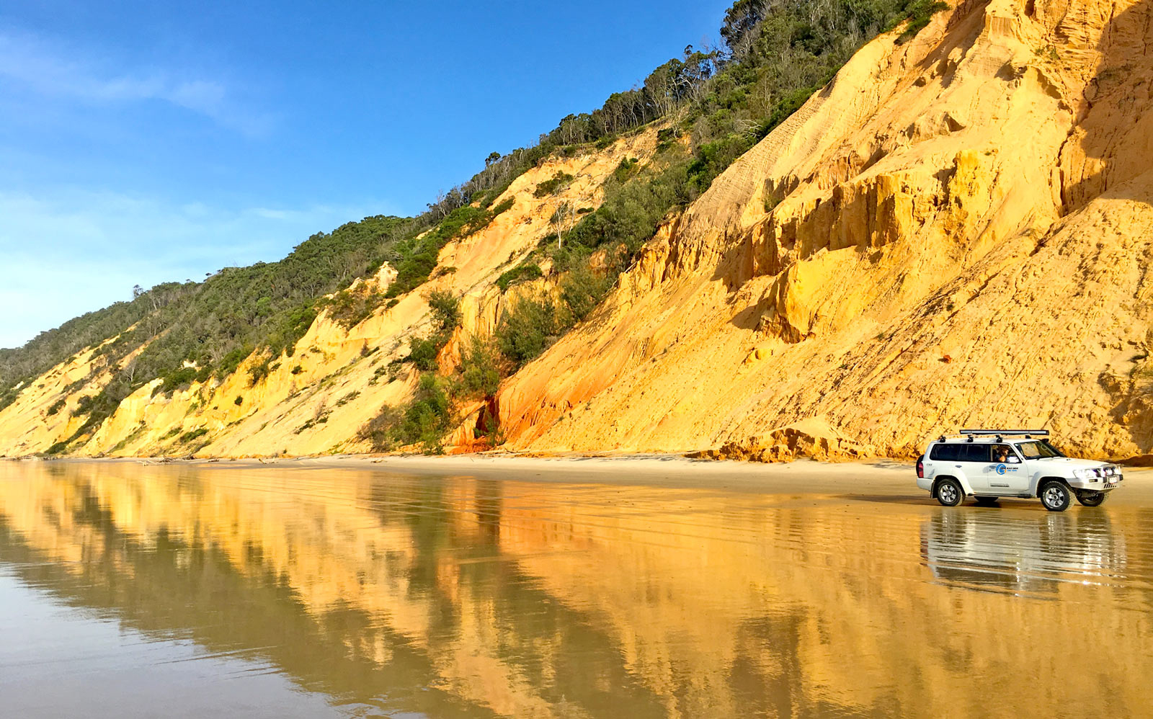
OUR VEHICLES
4WD WAGONS –
Maximum 4 adults
and 2 children
4WD MINI BUSES –
Maximum 10 people
Notes:
Our modern fleet of air-conditioned 4WD wagons and 11-seater 4WD buses offer a personalised experience where you will spend more time out than inside the vehicles with freedom to explore, relax and experience the stunning locations.

Slide 9
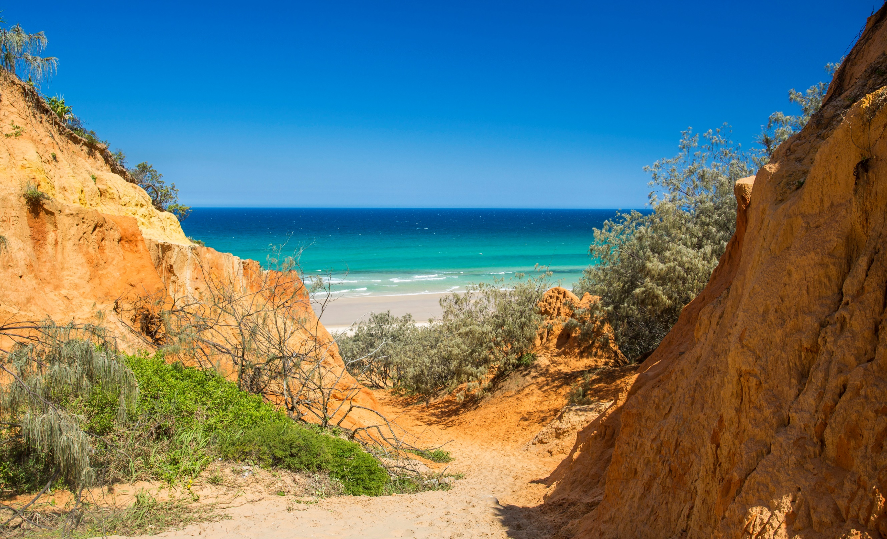
RED CANYON
Notes:
Red and yellow sands form a unique canyon in the sand dunes where you will enjoy magnificent views over Teewah Beach.

Slide 10
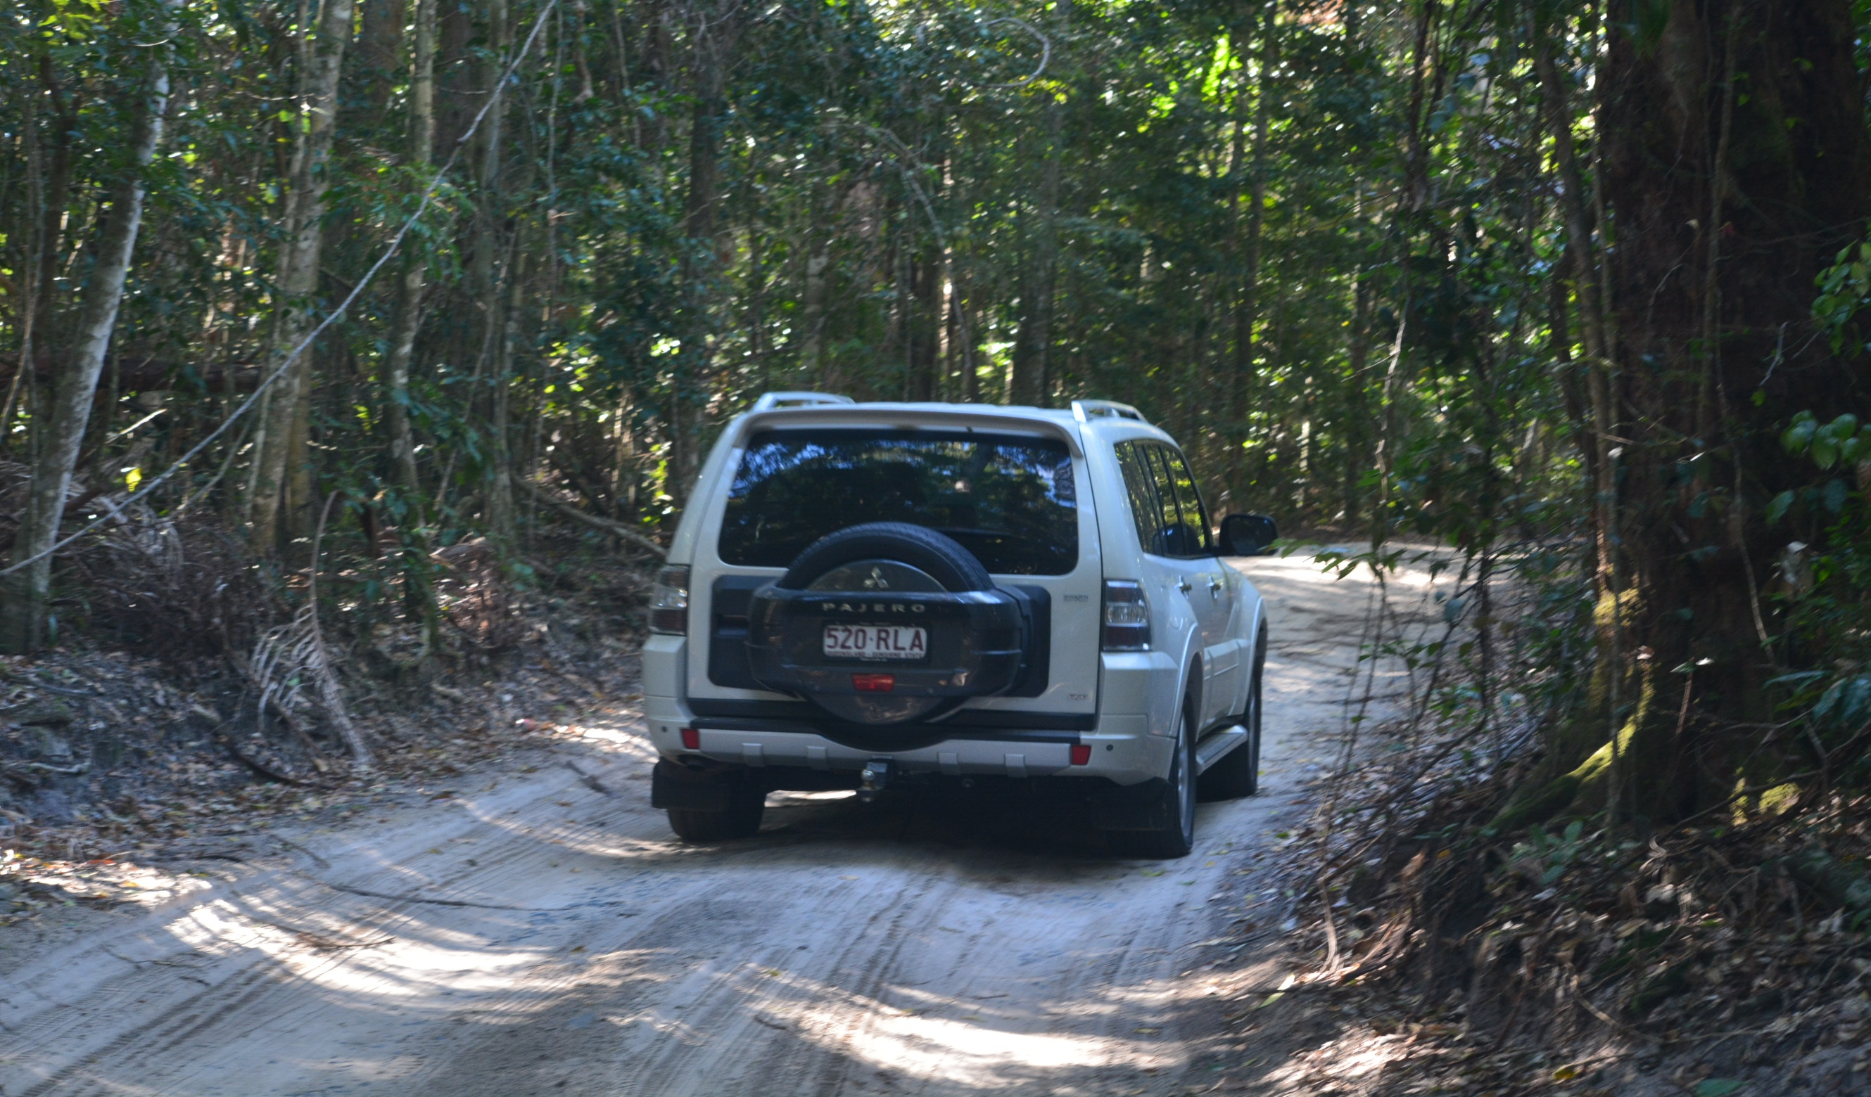
FRESHWATER TRACK
Notes:
A beautiful and unique rainforest drive through sand dunes, part of the Cooloola National Park which is a section of the Great Sandy National Park, stretching from the Noosa River to Rainbow Beach.

Slide 11
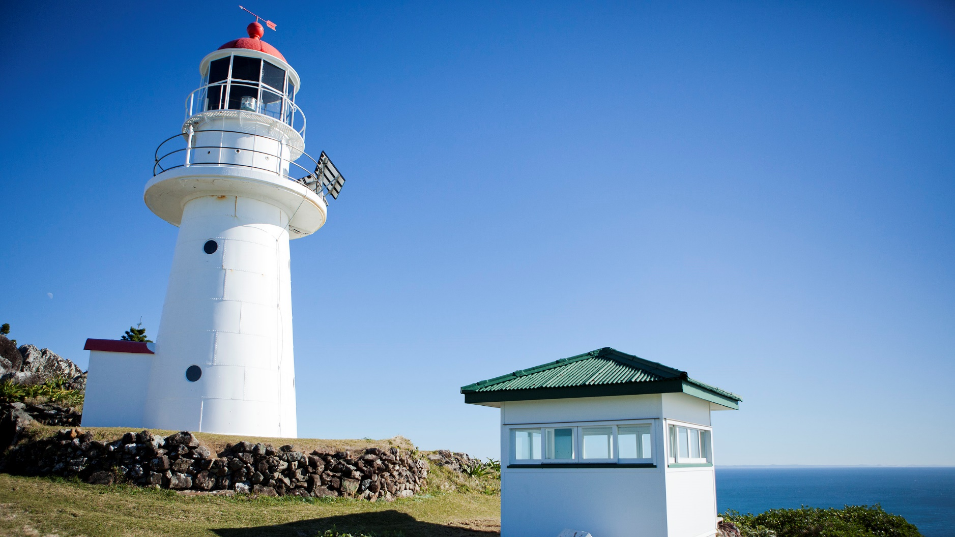
DOUBLE ISLAND POINT LIGHTHOUSE
with breathtaking 360 degree views from Noosa to Fraser Island
Notes:
Double Island Point Lighthouse offers breathtaking 360-degree views across the Pacific Ocean and scenic surrounds of the Great Sandy National Park. It is here we often spot pods of dolphins, turtles, sharks, manta rays and the majestic Humpback Whales (season is June-October). We are the only operators with access to the lighthouse, allowing you to see a parts of this popular spot otherwise missed.

Slide 12
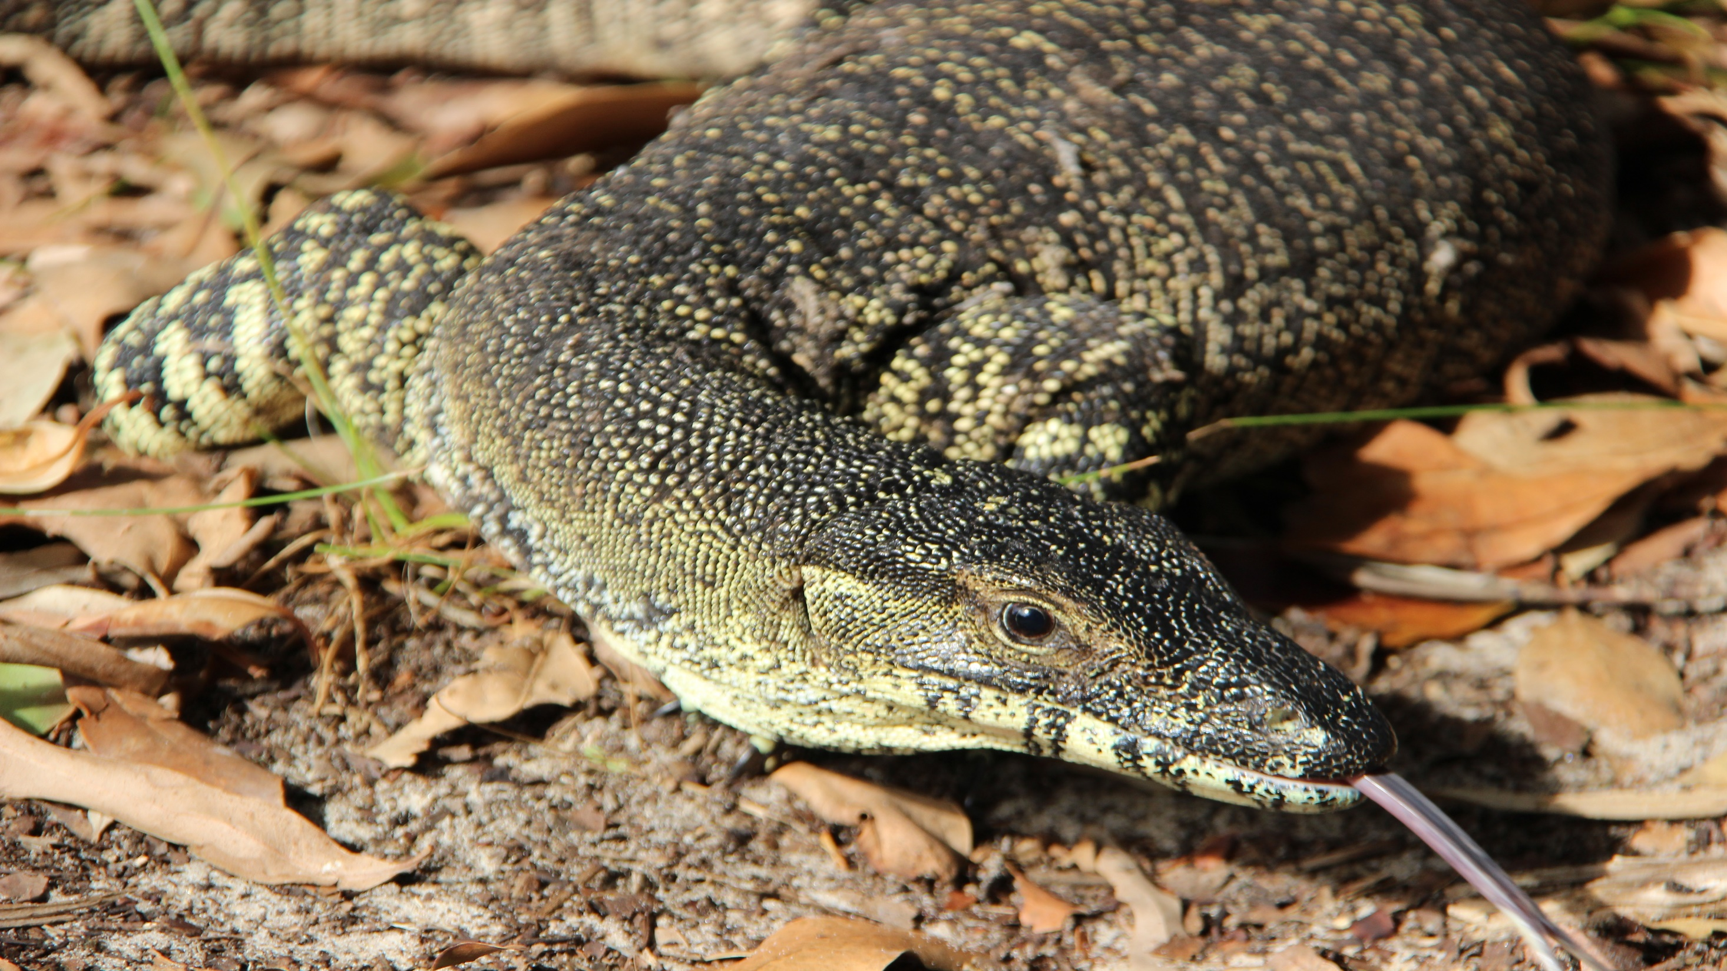
WILDLIFE, BIRDLIFE & MARINE LIFE
Notes:
A scenic and relaxing picnic ground in the Great Sandy National Park where we might be visited by Lace Monitors (Goannas), who love being photographed.

Slide 13
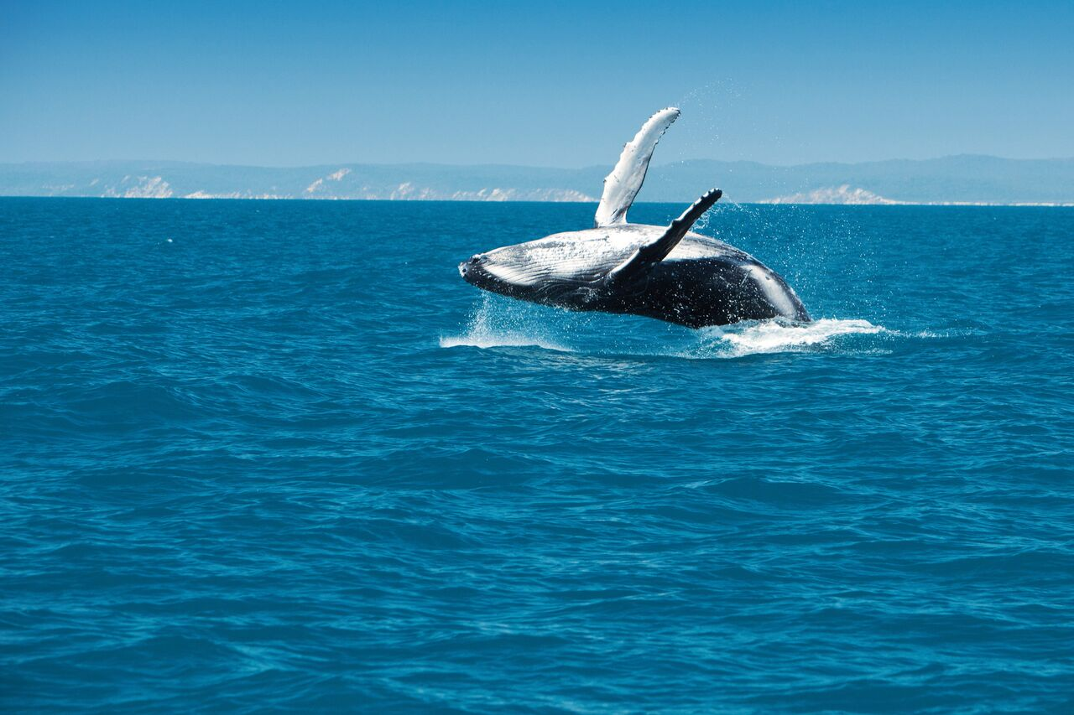
WHALE WATCHING – JUNE - OCTOBER

Slide 14
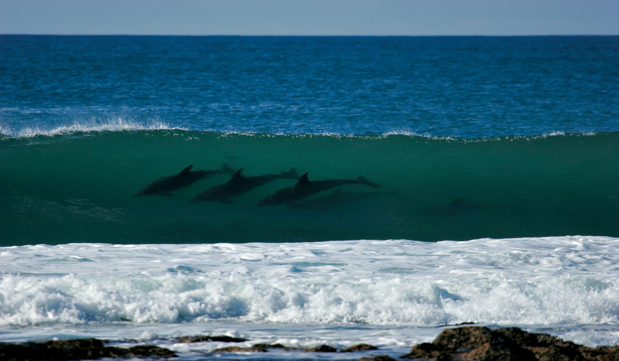
DOLPHINS, MANTA RAYS & TURTLES – ALL YEAR

Slide 15
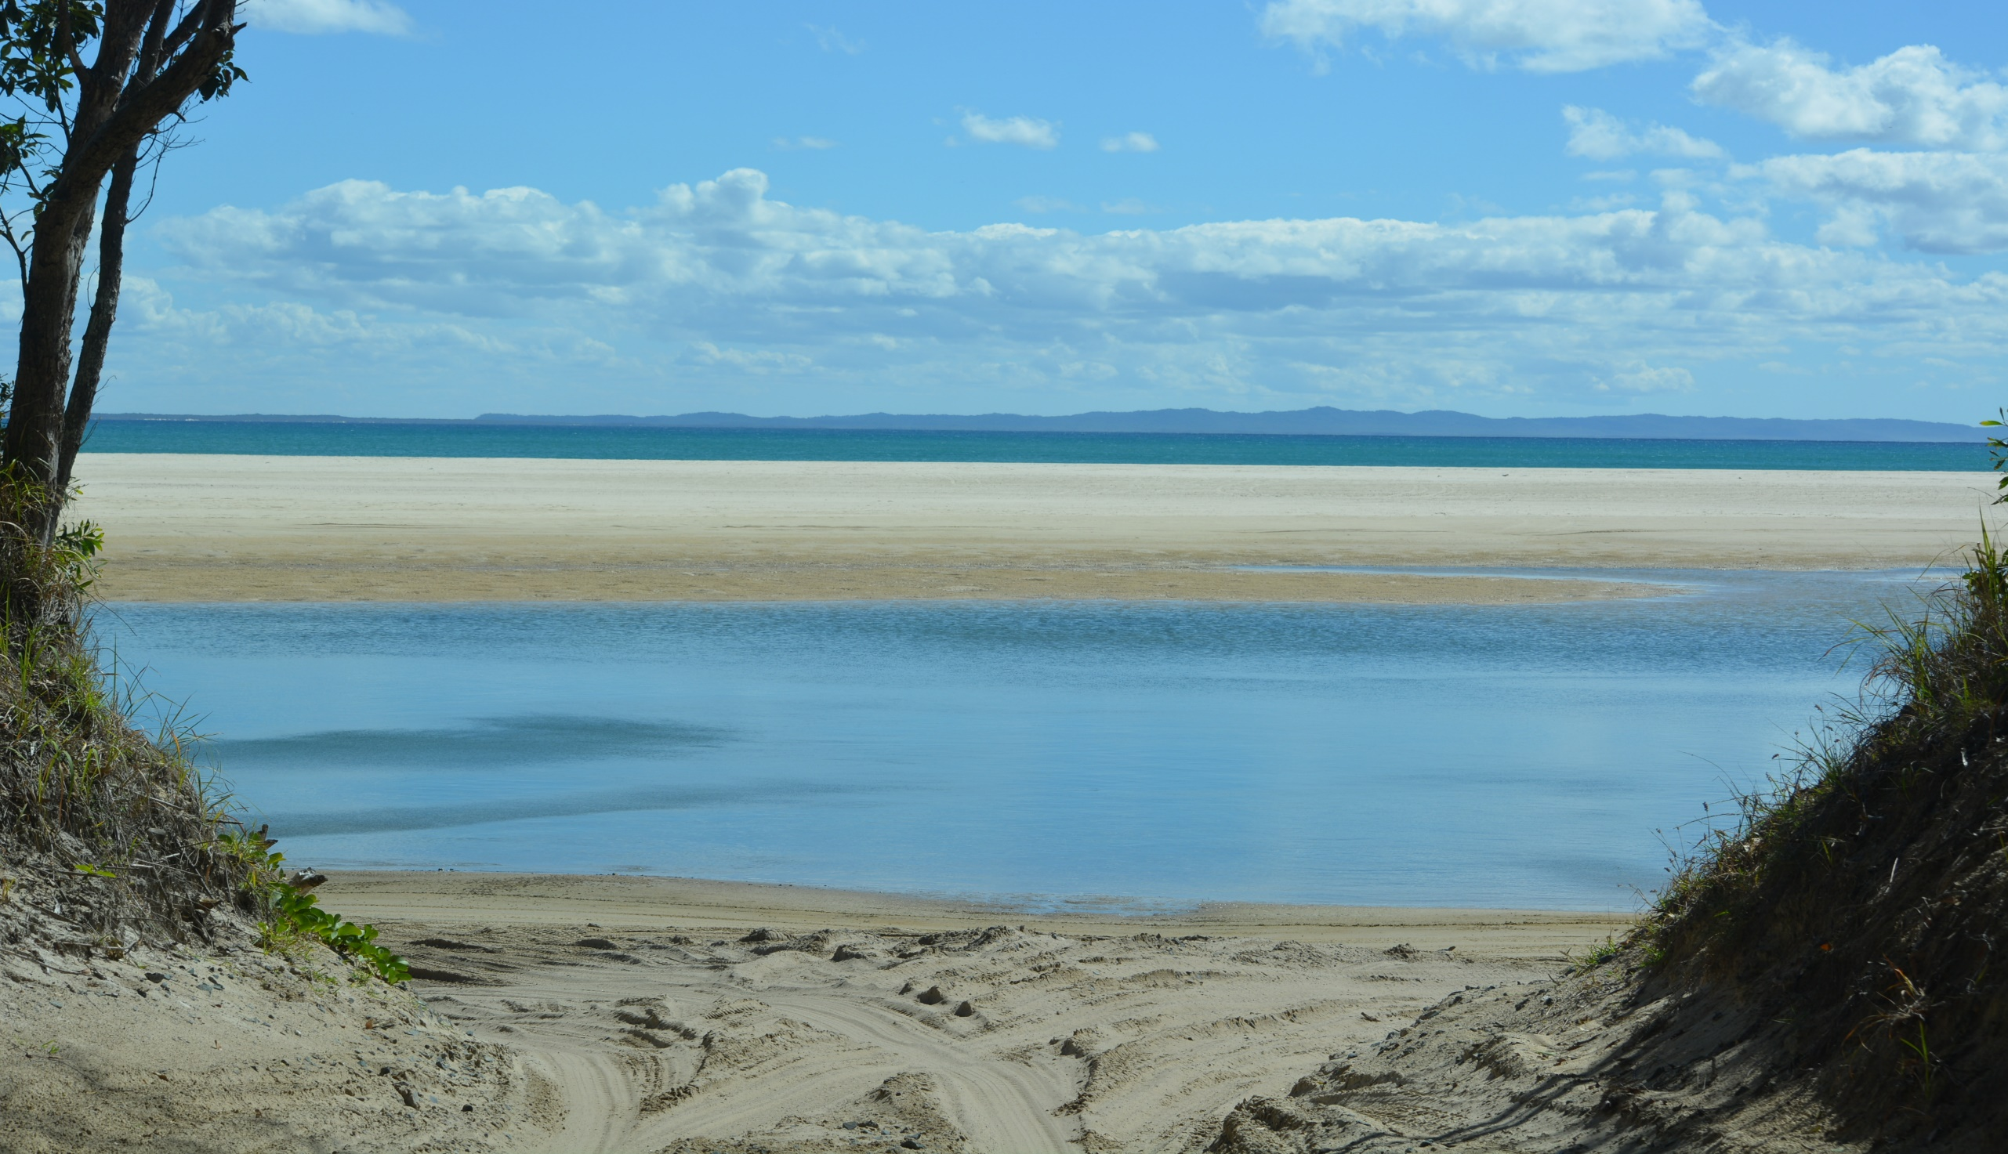
LEISHA TRACK

Slide 16
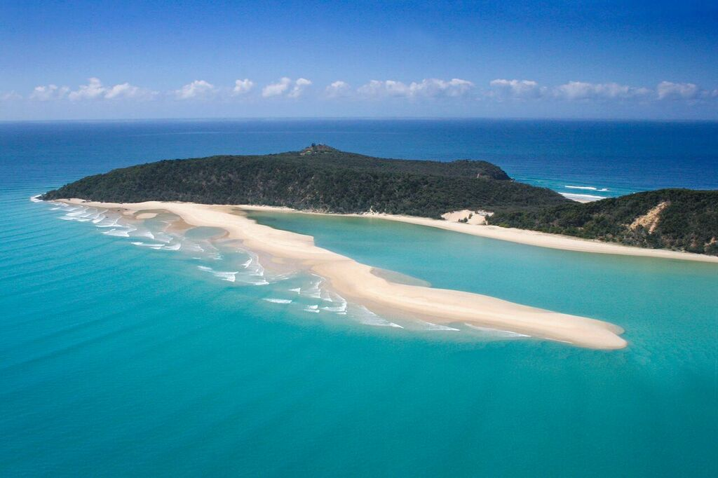
HONEYMOON BAY
Notes:
This area boasts a saltwater lagoon with some of the most scenic landscapes in Australia. Here we stop for a refreshing break, where you can swim in the protected waters of the bay, or body surf on the longest right hand breaks in Australia all year round..

Slide 17
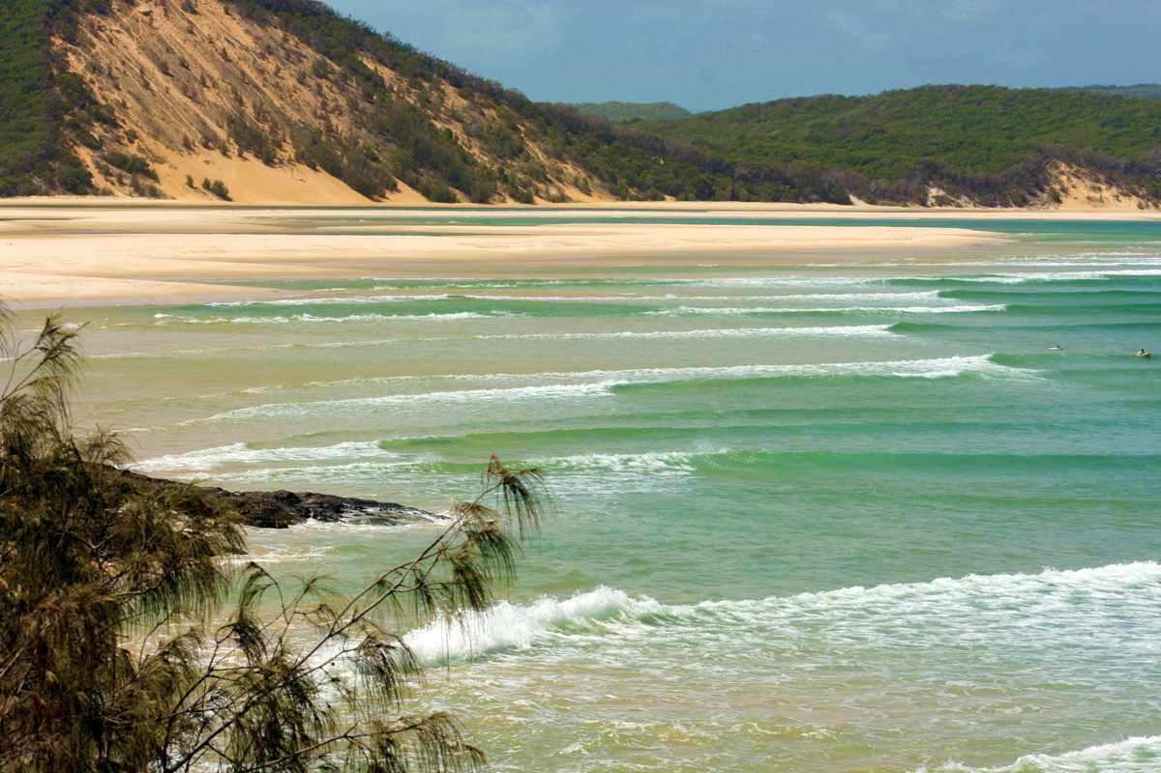

Slide 18
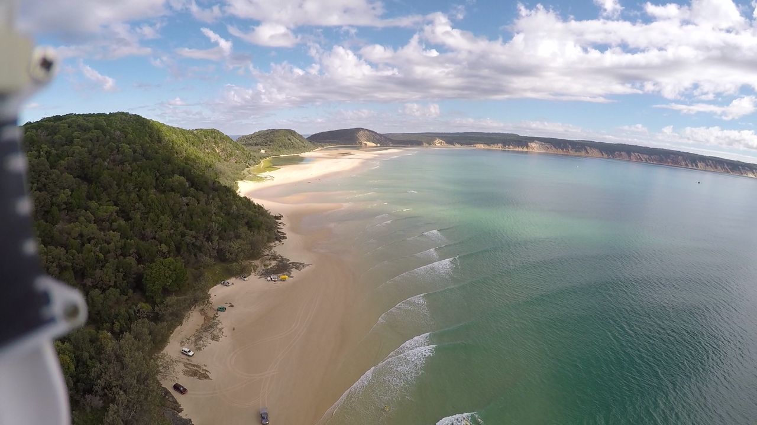

Slide 19
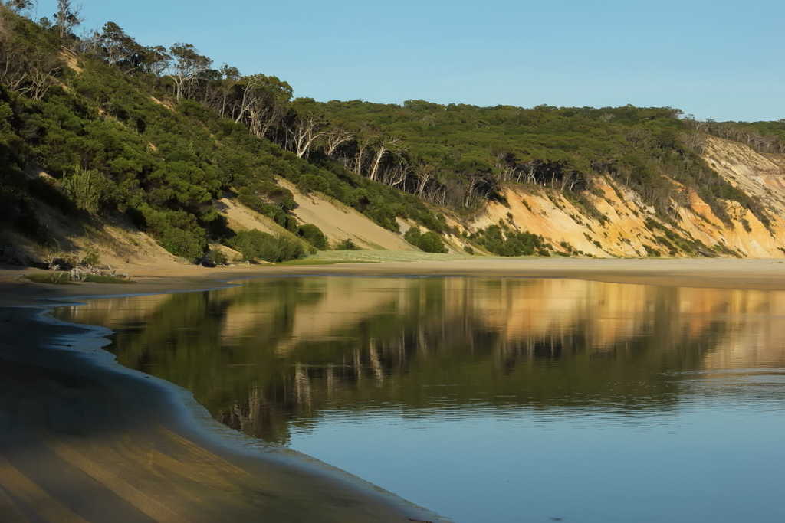

Slide 20
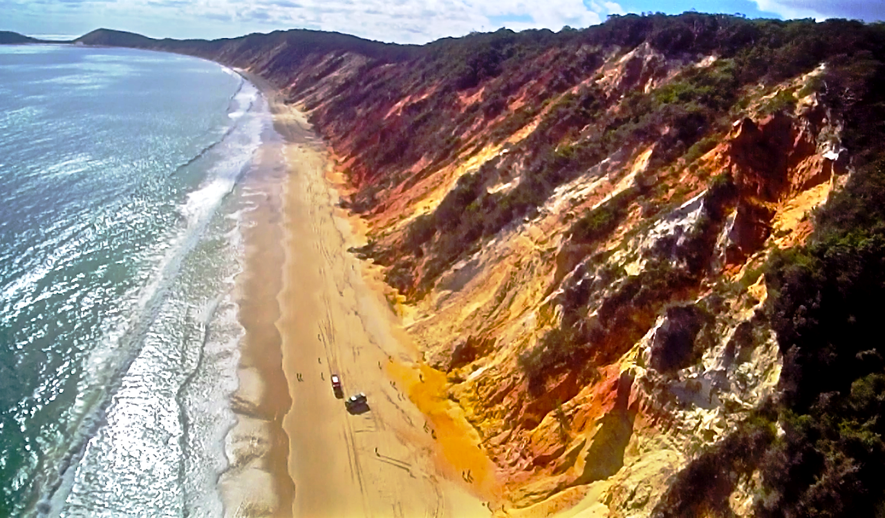
COLOURED SANDS
Notes:
This world famous attraction has more than 40 different shades of colour. The tour includes a demonstration of the traditional techniques used by the Aboriginal people to create artwork and decorate boomerangs.

Slide 21
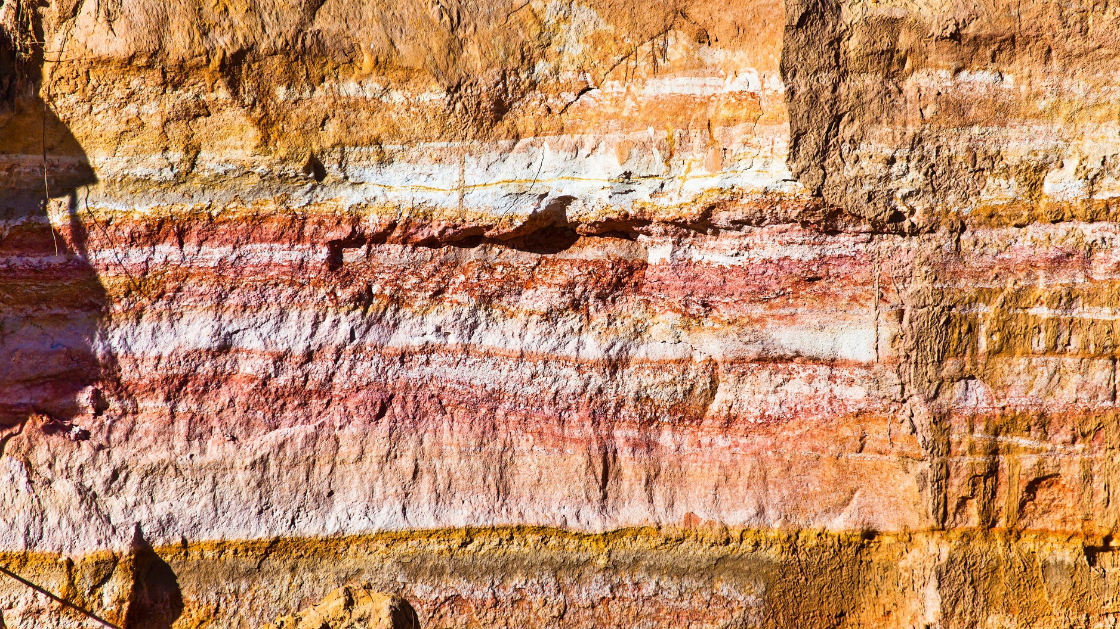

Slide 22
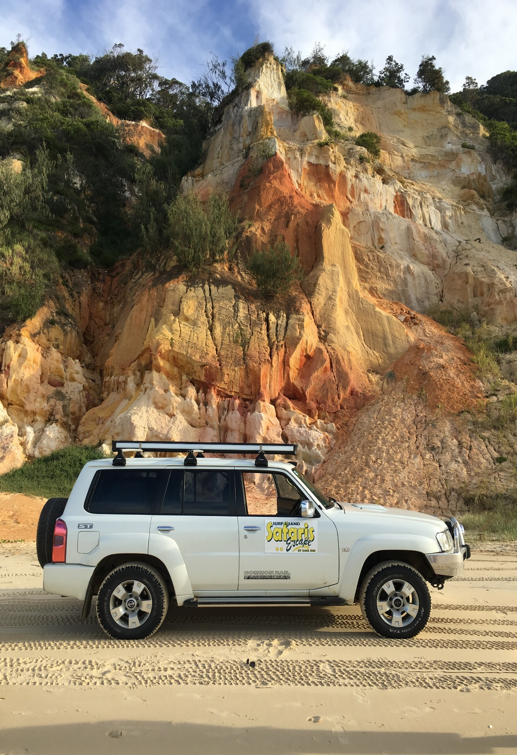
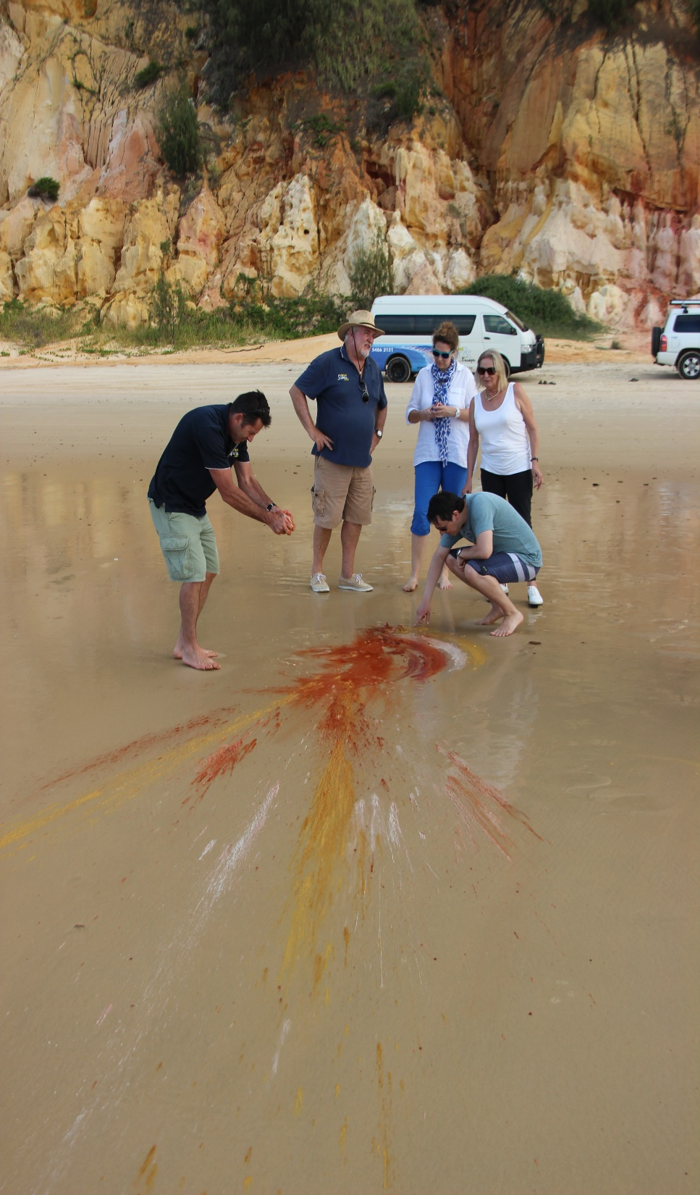
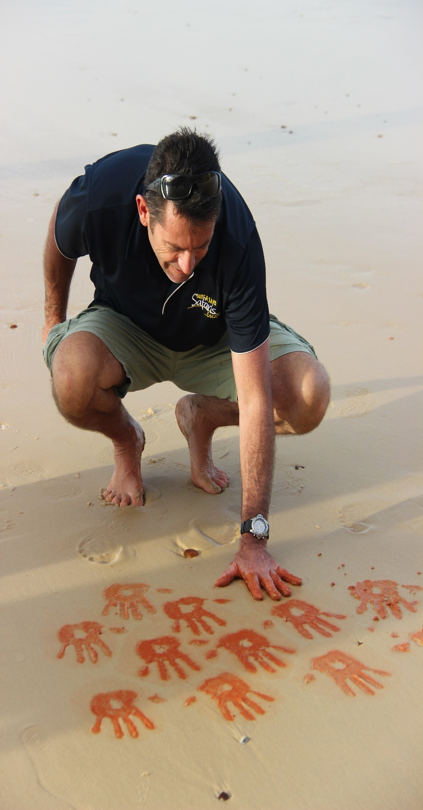
COLOURED SANDS DEMONSRATION

Slide 23
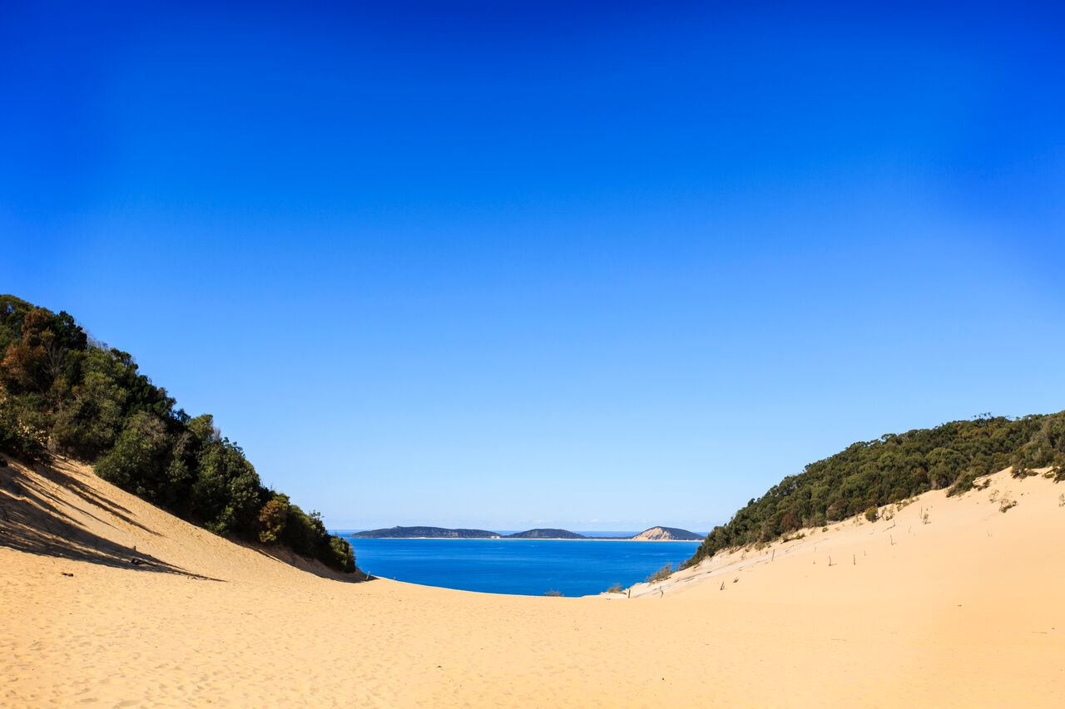
CARLO SAND BLOW
Notes:
Formed thousands of years ago, the Carlo Sandblow is a 15 hectare sand mass overlooking the ocean through to Double Island Point and the coloured sands.

Slide 24
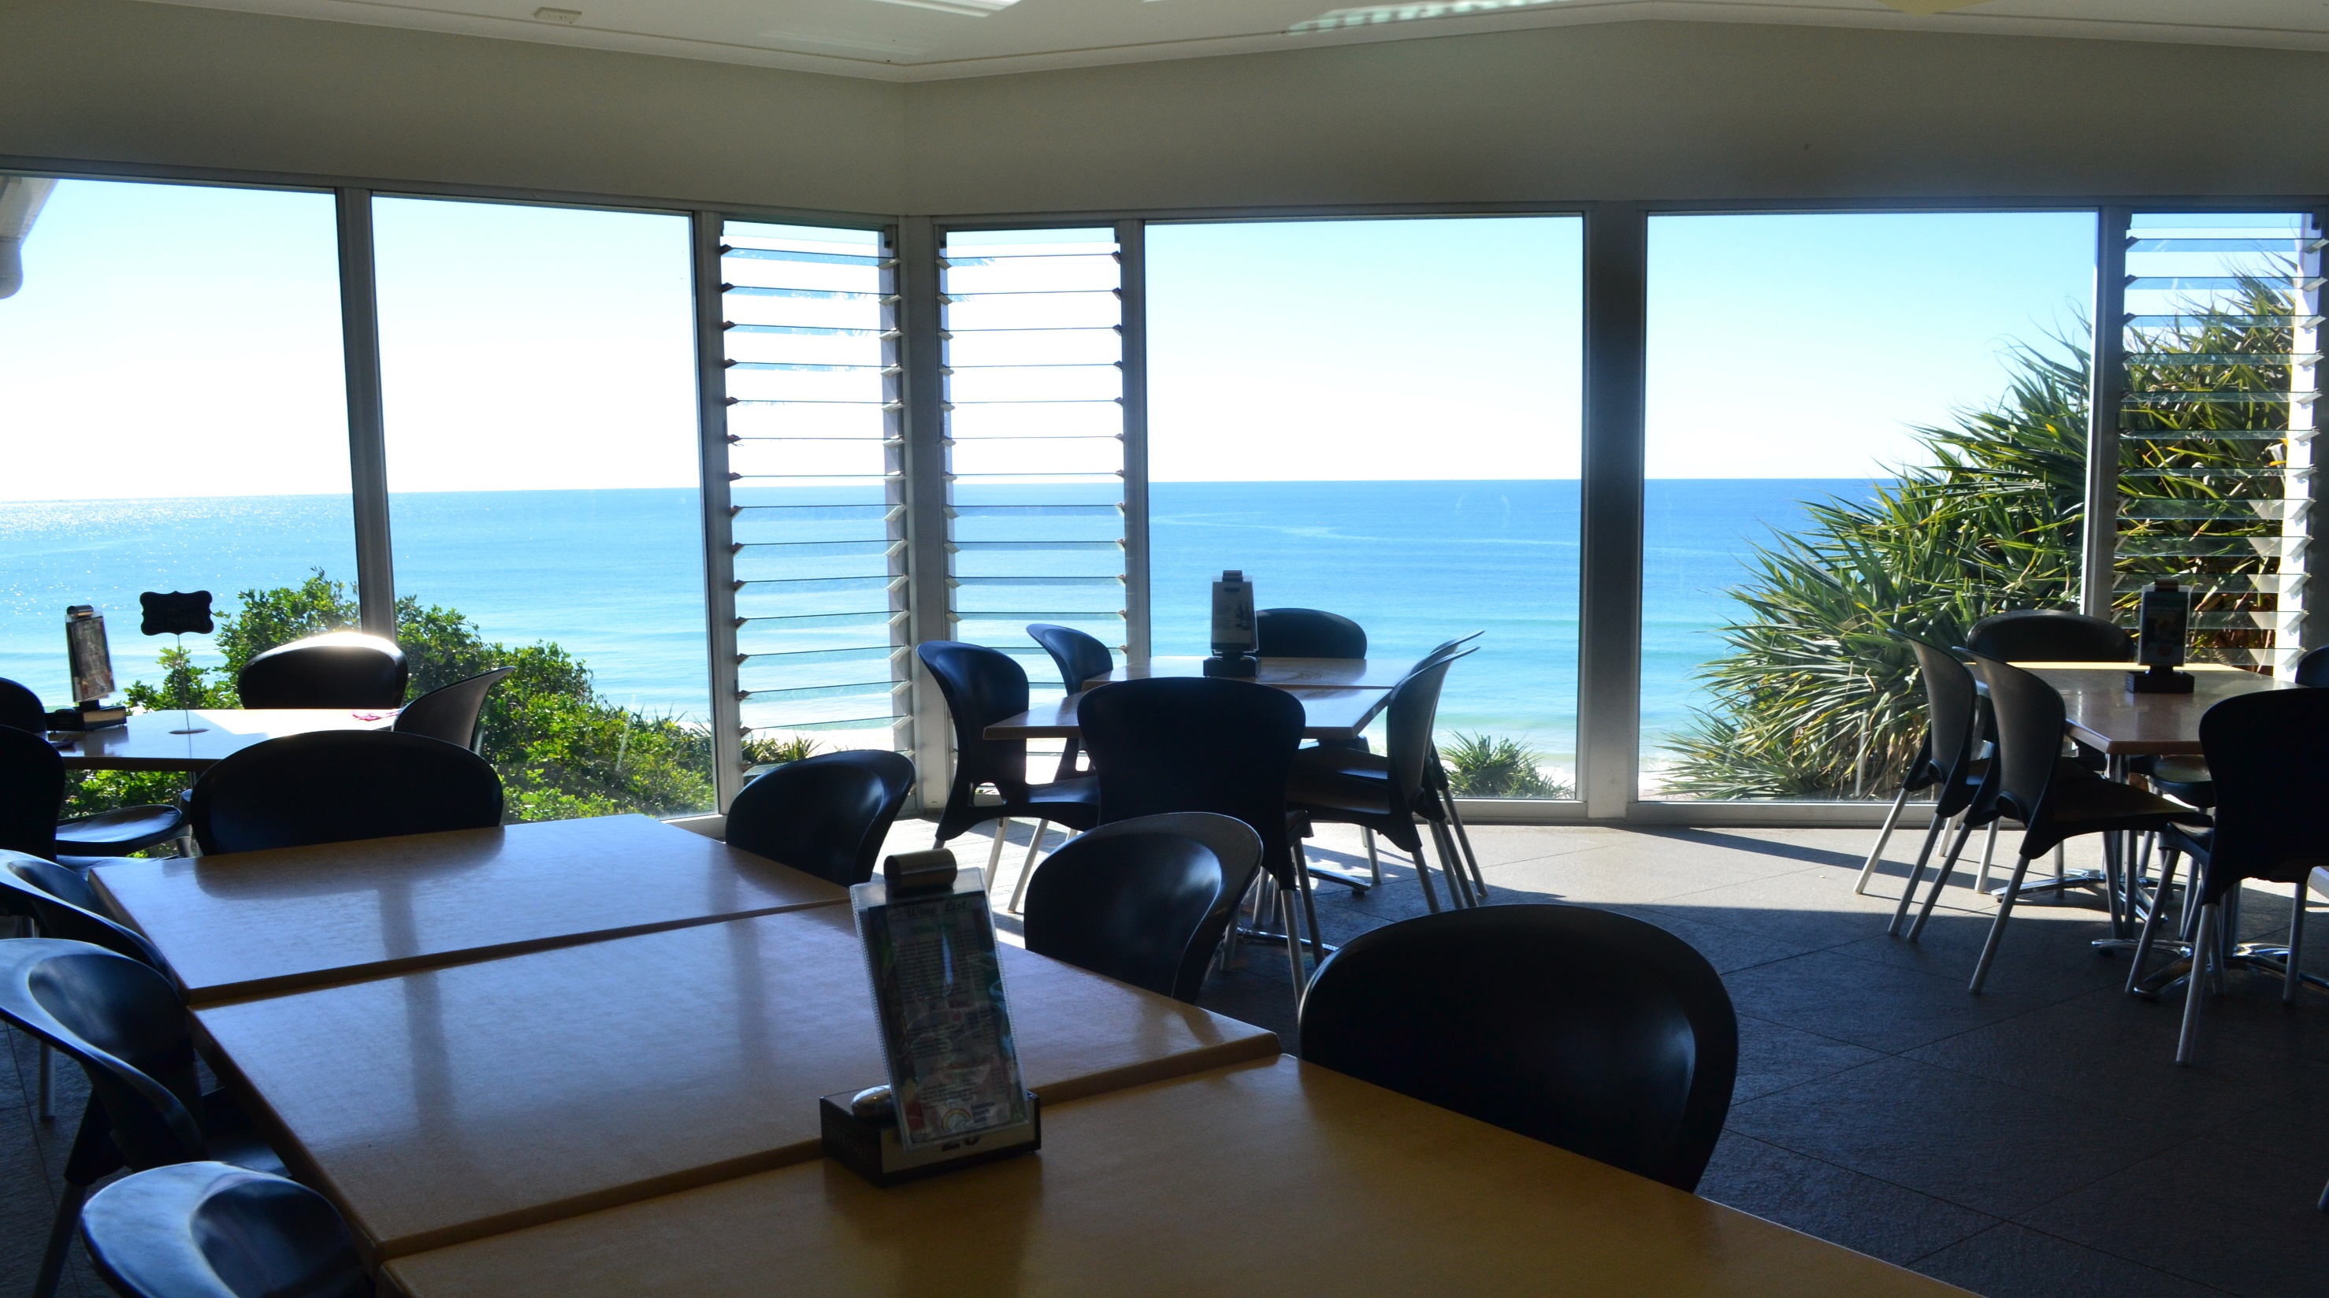
LUNCH VIEW – RAINBOW BEACH SURF CLUB
Notes:
Lunch at Rainbow Beach Surf Club includes a complimentary glass of beer, wine or soft drink

Slide 25
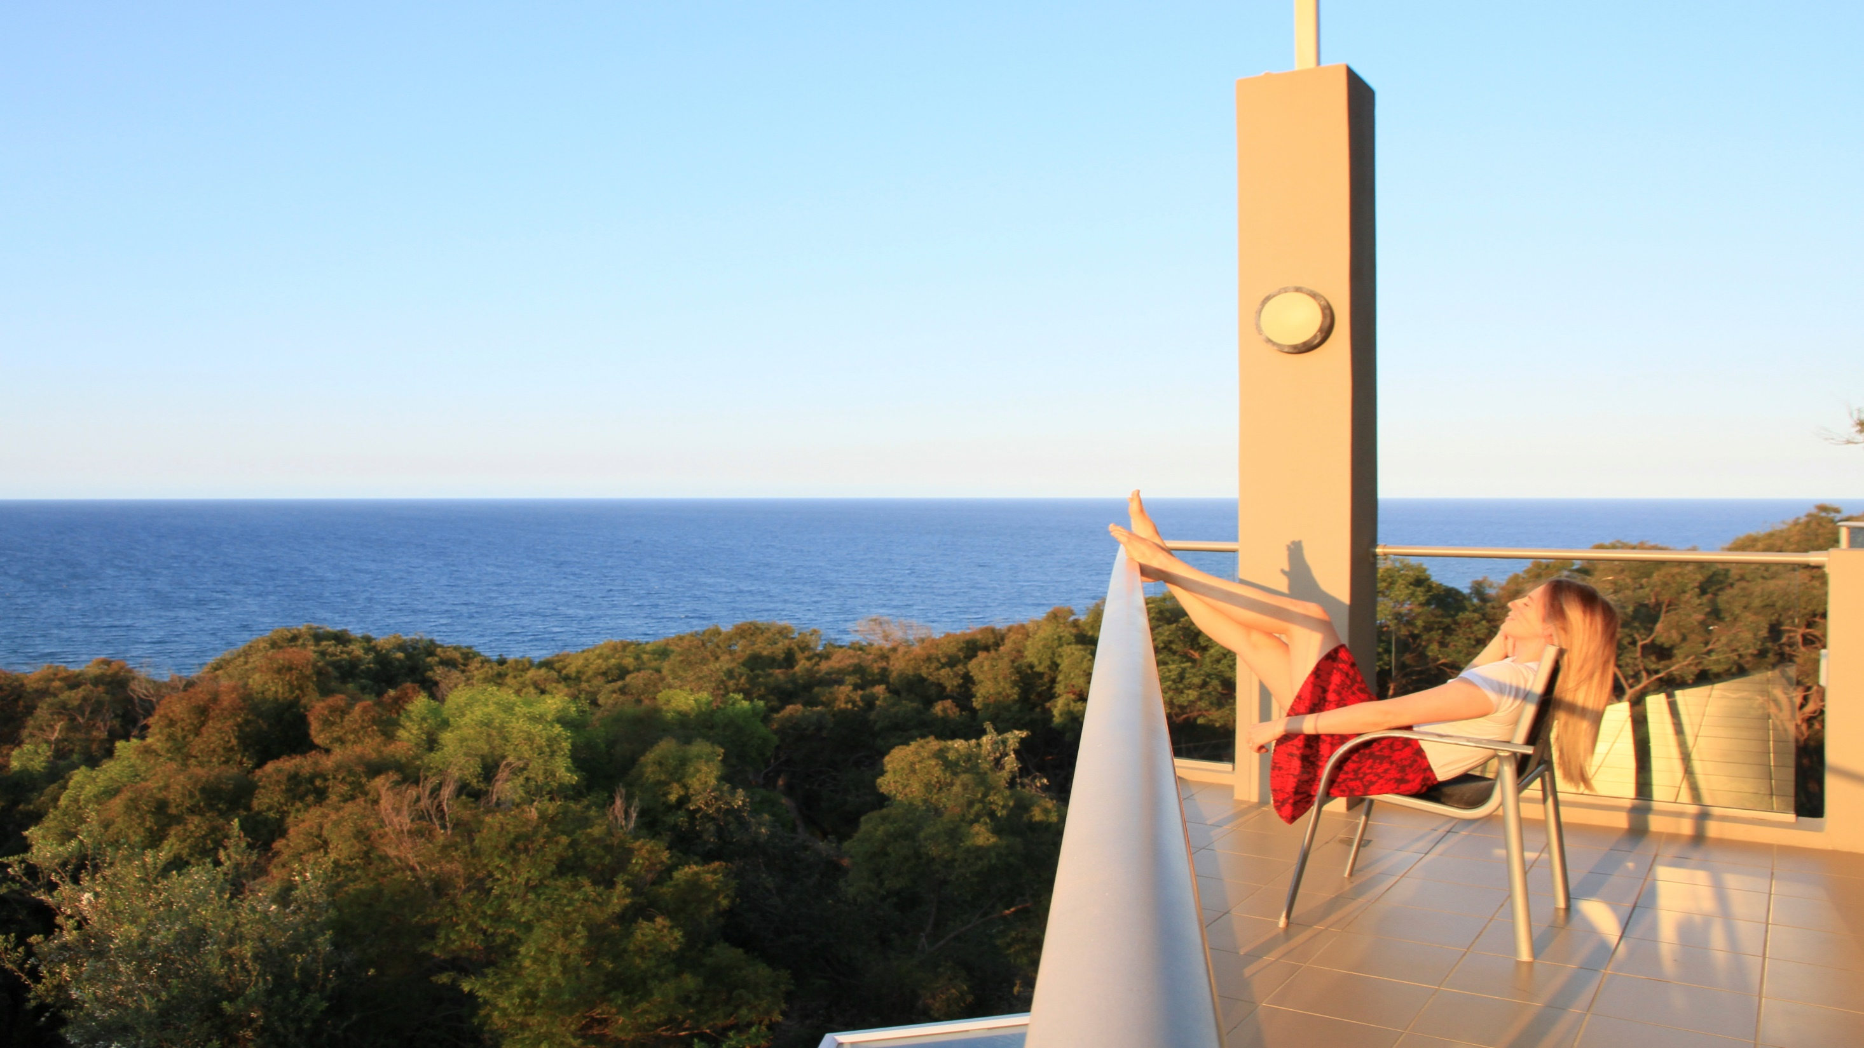
OVERNIGHT PACKAGES – RAINBOW OCEAN PALMS
Notes:
Overnight Great Beach Drive packages at Rainbow Ocean Palms, Rainbow Beach

Slide 26
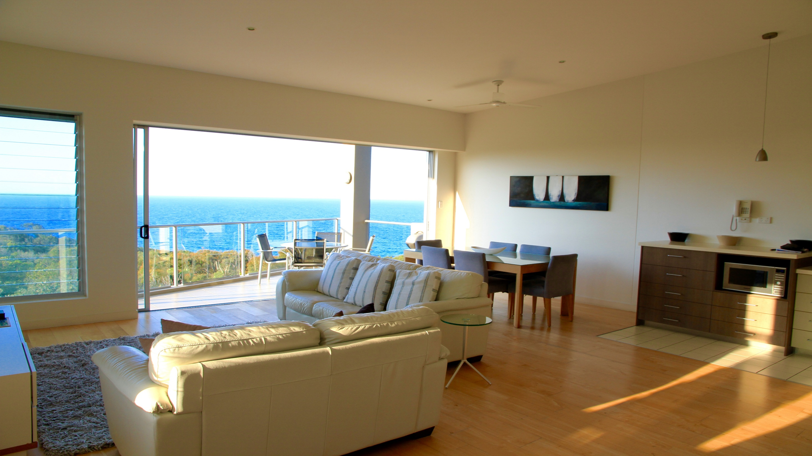
VIEW FROM RAINBOW OCEAN PALMS

Slide 27
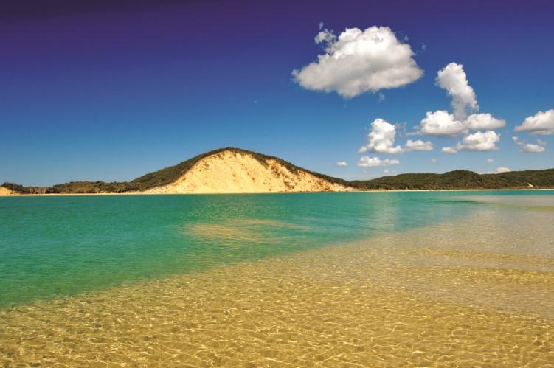
www.gbd4wdtours.com
Notes:
We are based in Queensland’s beautiful Sunshine Coast, and we would be delighted to help you with any queries, including group and special events you have regarding our Great Beach Drive Tours. Email: info@gbd4wdtours.com

